Slide 1
Java Collections Framework

Slide 2
Collection
A collection
represents a group of objects, known as its elements
may or may not allow duplicate elements
may be ordered or unordered

Slide 3
What is a Collections Framework?
A collections framework is a unified architecture for representing and manipulating collections
The Java Collections Framework (JCF) unifies the Java classes that allow users to manipulate collections of objects

Slide 4
The Collection Interface
in JCF, interfaces form the basis of the collections framework
the root interface in the JCF is the Collection interface

Slide 5
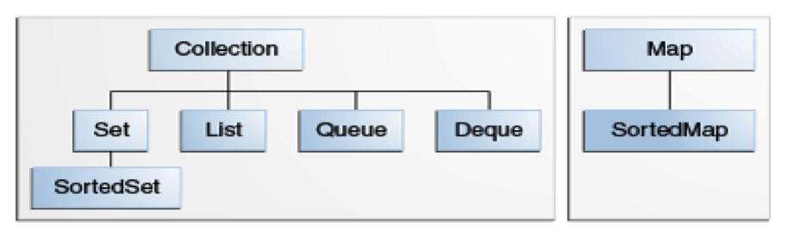
The Core Collection Interfaces
see http://docs.oracle.com/javase/tutorial/collections/interfaces/index.html for the Core Collection Interfaces

Slide 6
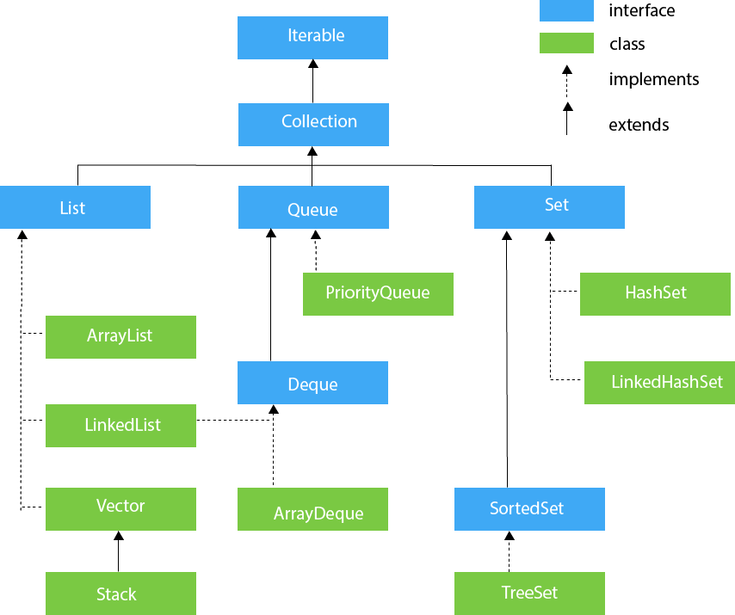
The Core Collection Interfaces
https://www.javatpoint.com/collections-in-java

Slide 7
The Collection Interface
the Collection interface declares methods useful for handling groups of objects
any time a class from the Java Collections Framework is used, the programmer knows that all the methods from the Collection interface are available and also understands the basic behavior required by the methods

Slide 8
The Collection Interface
thus the Collection interface supplies a common user interface to users of diverse classes and interfaces such as Set, SortedSet, Vector, LinkedList, ArrayList, and many others

Slide 9
The Basic Interfaces
the Collection interface specifies methods that all implementations must provide, including
isEmpty
add
remove
size

Slide 10
The Basic Interfaces
Set
no duplicate elements
implemented by
HashSet
uses a hash table for storage
contains unique items
TreeSet
uses a search tree in which search operation takes O(log n)
contains unique items

Slide 11
The Basic Interfaces
List
duplicate elements allowed
implemented by
ArrayList
is a resizable array
grows its size to accommodate new elements and shrinks the size when the elements are removed
LinkedList
is a linear collection of elements whose order is not given by their physical placement in memory
each element points to the next

Slide 12
The Basic Interfaces
Queue
designed to hold elements prior to processing
typically uses a FIFO (first-in-first-out) design so elements are added to the tail of the queue and removed from the front
implemented by AbstractQueue

Slide 13
The Basic Interfaces
Deque
pronounced as “deck”
a double-ended queue: can insert and delete elements at either end of the queue

Slide 14
The Basic Interfaces
Map interface
represents objects that map keys to values
Values could be duplicated
implemented by
HashMap
allows single null key, but can have multiple null values
allows heterogeneous key values
TreeMap
sorts the keys in ascending order
allows only homogeneous key values

Slide 15
The toString Method
Java provides the abstract class AbstractCollection that implements Collection, providing implementations for most of the methods in Collection
in addition, AbstractCollection provides a toString method to print collections

Slide 16
The toString Method
the toString method returns a String consisting of the elements in the collection, in the same order as returned by the iterator, separated by commas, and enclosed in square brackets

Slide 17
Iterators
the Collection interface specifies an iterator method that returns an Iterator over the elements in the class
an Iterator object has methods
hasNext (returns true if there are more elements in the iteration)
next (moves to the next element in the iteration)

Slide 18
Example
assume myList is a list of integers
this code creates an iterator that will iterate through the list, printing each value
Iterator<Integer> myItr = myList.iterator();
while(myItr.hasNext())
{ System.out.println(myItr.next());
}

Slide 19
Example
for(Integer i : myList)
{
System.out.println(i);
}
Note: This example can also be implemented using an enhanced for loop

Slide 20
Java Collections Framework
The End

